Slide 1

CDR
Team 27

Slide 2
Introduction
Sreeram Andra
Computer Engineer: vssa8989@bu.edu
Anirudh Singh
Computer Engineer: ansingh@bu.edu
Vansh Bhatia
Electrical Engineer: vansh@bu.edu
Akhil Bongu
Computer Engineer: akbongu@bu.edu

Slide 3
Problem Statement
The modern smart home ecosystem is highly fragmented, with separate solutions for security, energy monitoring, and automation. These systems often rely on cloud-based processing, leading to latency, security risks, and lack of seamless integration. Domus solves this by offering a unified, edge-based smart home system that combines multiple functionalities into a single, privacy-focused, real-time solution.
Notes:
Ram

Slide 4
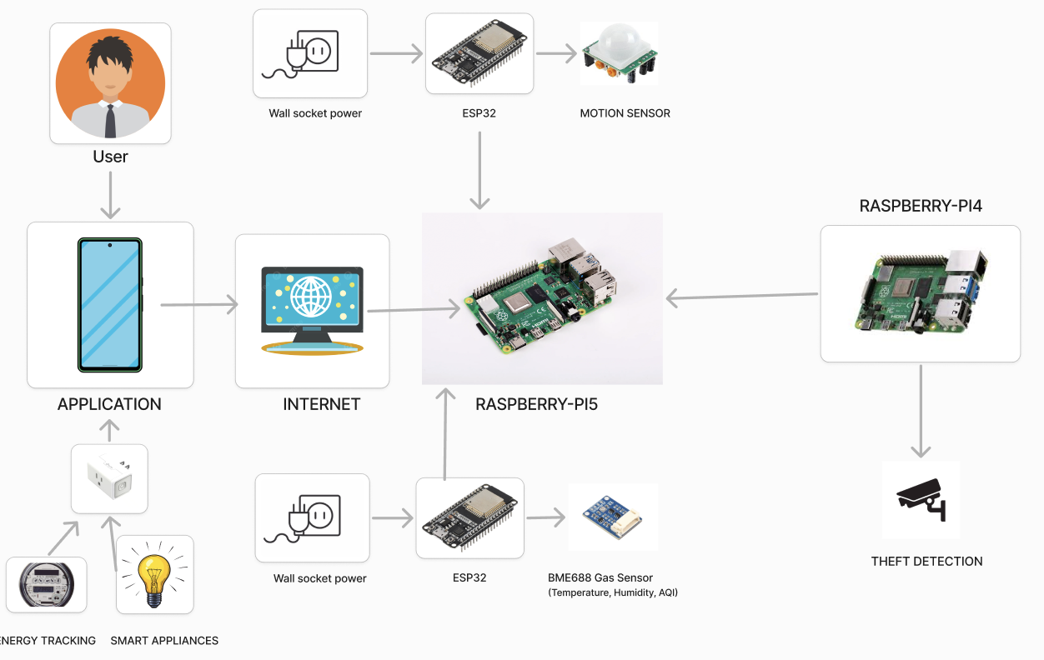
Notes:
Ram

Slide 5
Design Review/Technologies used
HARDWARE COMPONENT | PURPOSE
Raspberry Pi 5 | Central Microprocessor
Raspberry Pi 4B | Microprocessor for Camera
ESP32 Devkit S1 | Microprocessor for edge Sensors
HCSR 501 | Collects Motion Data
BME 688 | Collects Environmental Conditions Data
Smart Plug (Kasa KP 115) | Measures Energy Consumption
Camera (IMX 500 Raspberry Pi AI) | Collects Video Footage
Edge Modules | Houses Edge Circuits
Notes:
Vansh

Slide 6
Power requirement
Subsystem | Voltage (V) | Current (A) | Total Power consumed per subsystem (W)
Raspberry Pi 5 | 5 | 0.5 | 2.5
Raspberry Pi 4 | 5 | 0.275 | 1.375
ESP32 Devkit S1 (x2) | 3.3 | 0.15 | 0.99
HCSR 501 | 5 | 0.06 | 0.3
BME 688 | 3.3 | 0.015 | 0.0495
Kasa smart plug KP115 | 120 | 0.015 | 1.8
Raspberry pi AI camera | 3.3 | 0.56 | 1.848
Total Estimated Power Consumption |  |  | 8.8625
Notes:
Vansh

Slide 7
Design Review/Technologies used
SOFTWARE COMPONENT | PURPOSE
C++ Code Files | Collect data from edge sensors
LLM (GPT 3.5 Turbo) | User interactivity
React-Native | UI Interface
Computer Vision Model (dlib + OpenCV) | Facial Recognition
Object Detection Model (MobileNet SSD V2) | Detects objects in camera’s field of view
Activity Recognition Model (MoveNet + LSTM) | Detects human activities in camera’s field of view
SolidWorks | Housing Unit Design
SQLite | Database Storage
WebSocket protocol | Two way real time data communication
Gstreamer protocol | Live streaming of camera footage
Notes:
Vansh

Slide 8
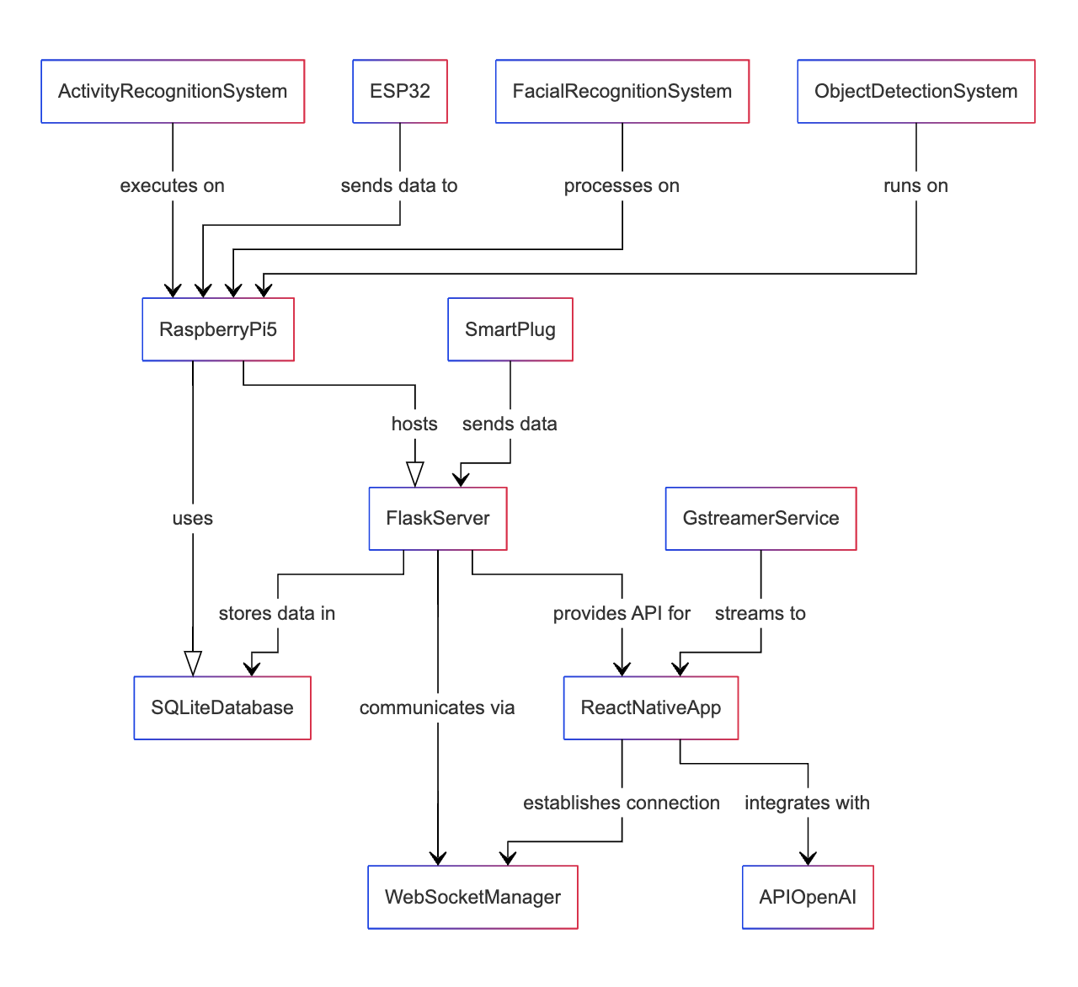
Software UML Schematic
Notes:
Akhil

Slide 9
Completed Work (Technical Progress)
Edge-to-Edge Completion
All sensors (motion, air quality, temperature) collect data seamlessly
Real-time communication to Raspberry Pi 5 and app integration
Functional LLM Integration
Smart home assistant understands and responds to queries
Energy Visualization
Graphical energy trends for better monitoring and interactivity
Live tracking of smart plug energy consumption
Fully Functional Application
Temperature monitoring, intruder detection, and alerts
Energy data collection and display in the app
Object and Face Detection
Accurate facial and object detection and notification
Notes:
Akhil

Slide 10
Measurable criteria so far
FEATURE | METRIC | OUTCOME
Motion Detection | Detection Accuracy | 100%
Theft Detection | Facial recognition latency | <1 second
Environmental Sensing | Temperature Accuracy | ±1°C
 | Other Metric Accuracy | ±2%
Energy Tracking | Toggle latency for devices | <1 second
 | Real-time power consumption display | Accurate
Object and Action Detection | Detection Confidence | 90%+ for most objects
Notes:
Ram

Slide 11
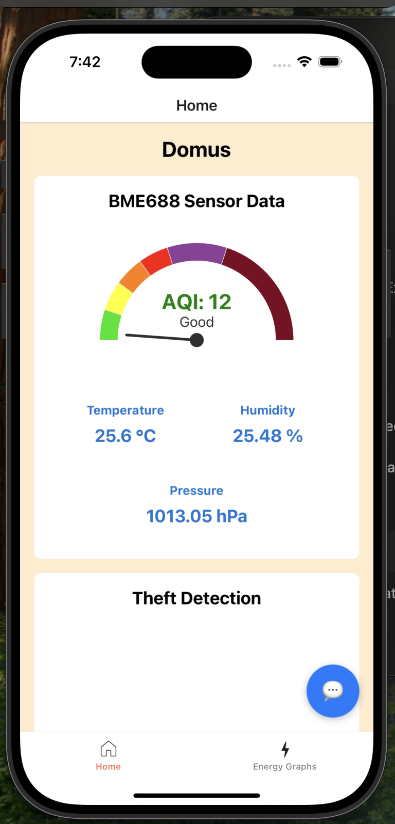
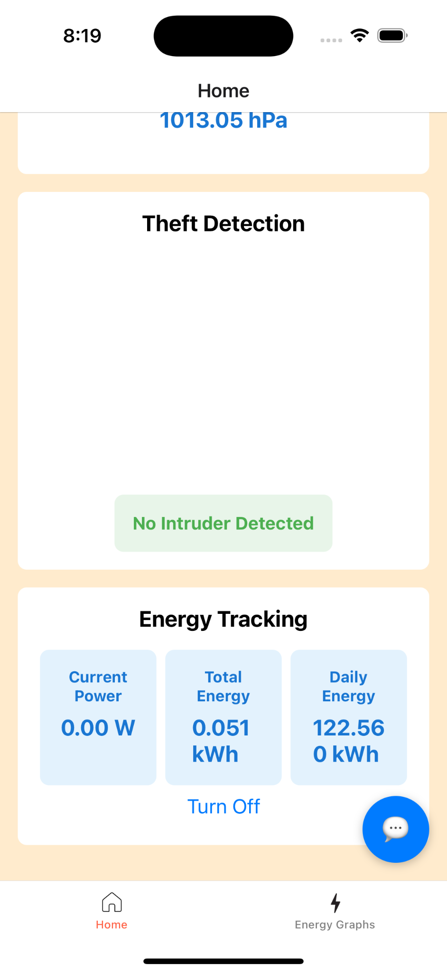

Slide 12
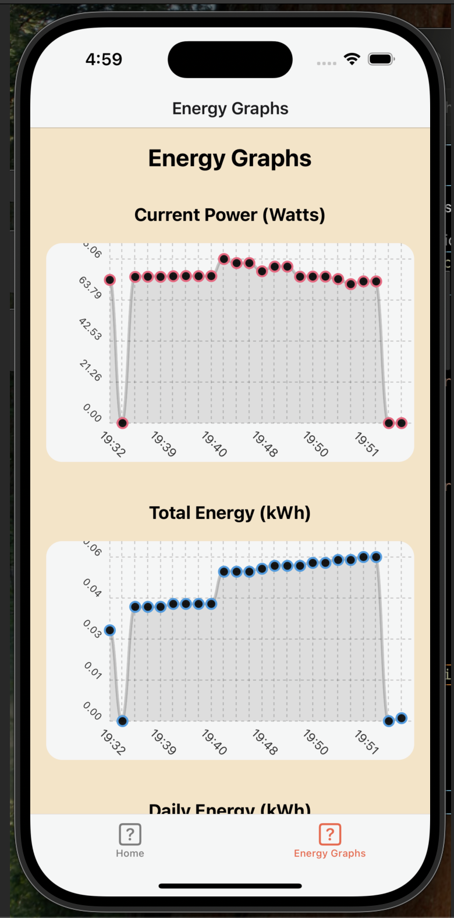
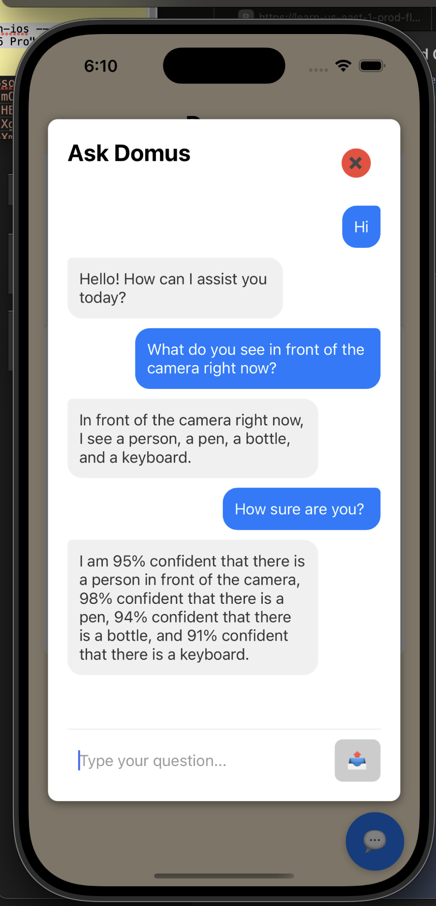

Slide 13
Challenges
Challenge | Possible Improvement
Communicating through a single network | Try out BU WiFi with a personal router through a LAN connection
Crafting ergonomic housing units | Optimize design with durable materials and modular components.
Designing an interactive UI | Further iterative development
Streaming quality footage from the camera | Attempt with different streaming protocols/stream to the app directly and run inference on the camera
Notes:
Ram

Slide 14
Work needed for completion
LLM optimization + voice command integration
App Design
Housing Units
Refinement of Theft Detection System
Predictive Analysis of Energy Usage
Reliable Activity Recognition model
Notes:
Vansh

Slide 15
Final Deliverables
A smart home system, complete with edge sensors and processors within housing units that are easy to place and plug
An interactive application as a one-stop shop for visualizing and understanding all the data from the smart home system
A fully functional LLM in the application with which the user can interact with through voice/text
Notes:
Akhil

Slide 16
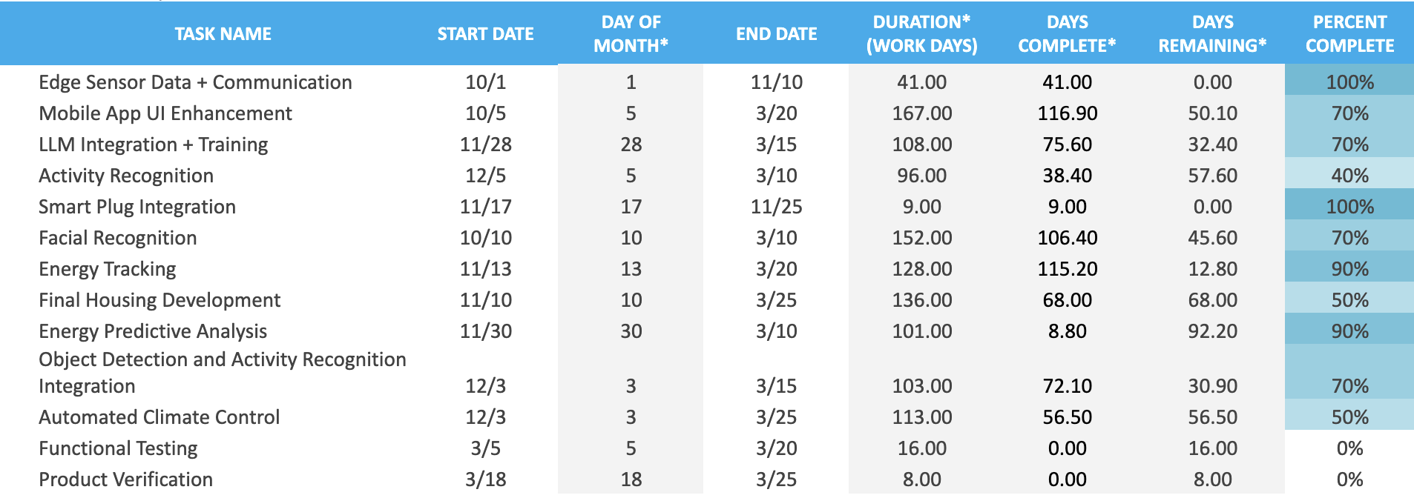
Timeline
Notes:
Akhil

Slide 17
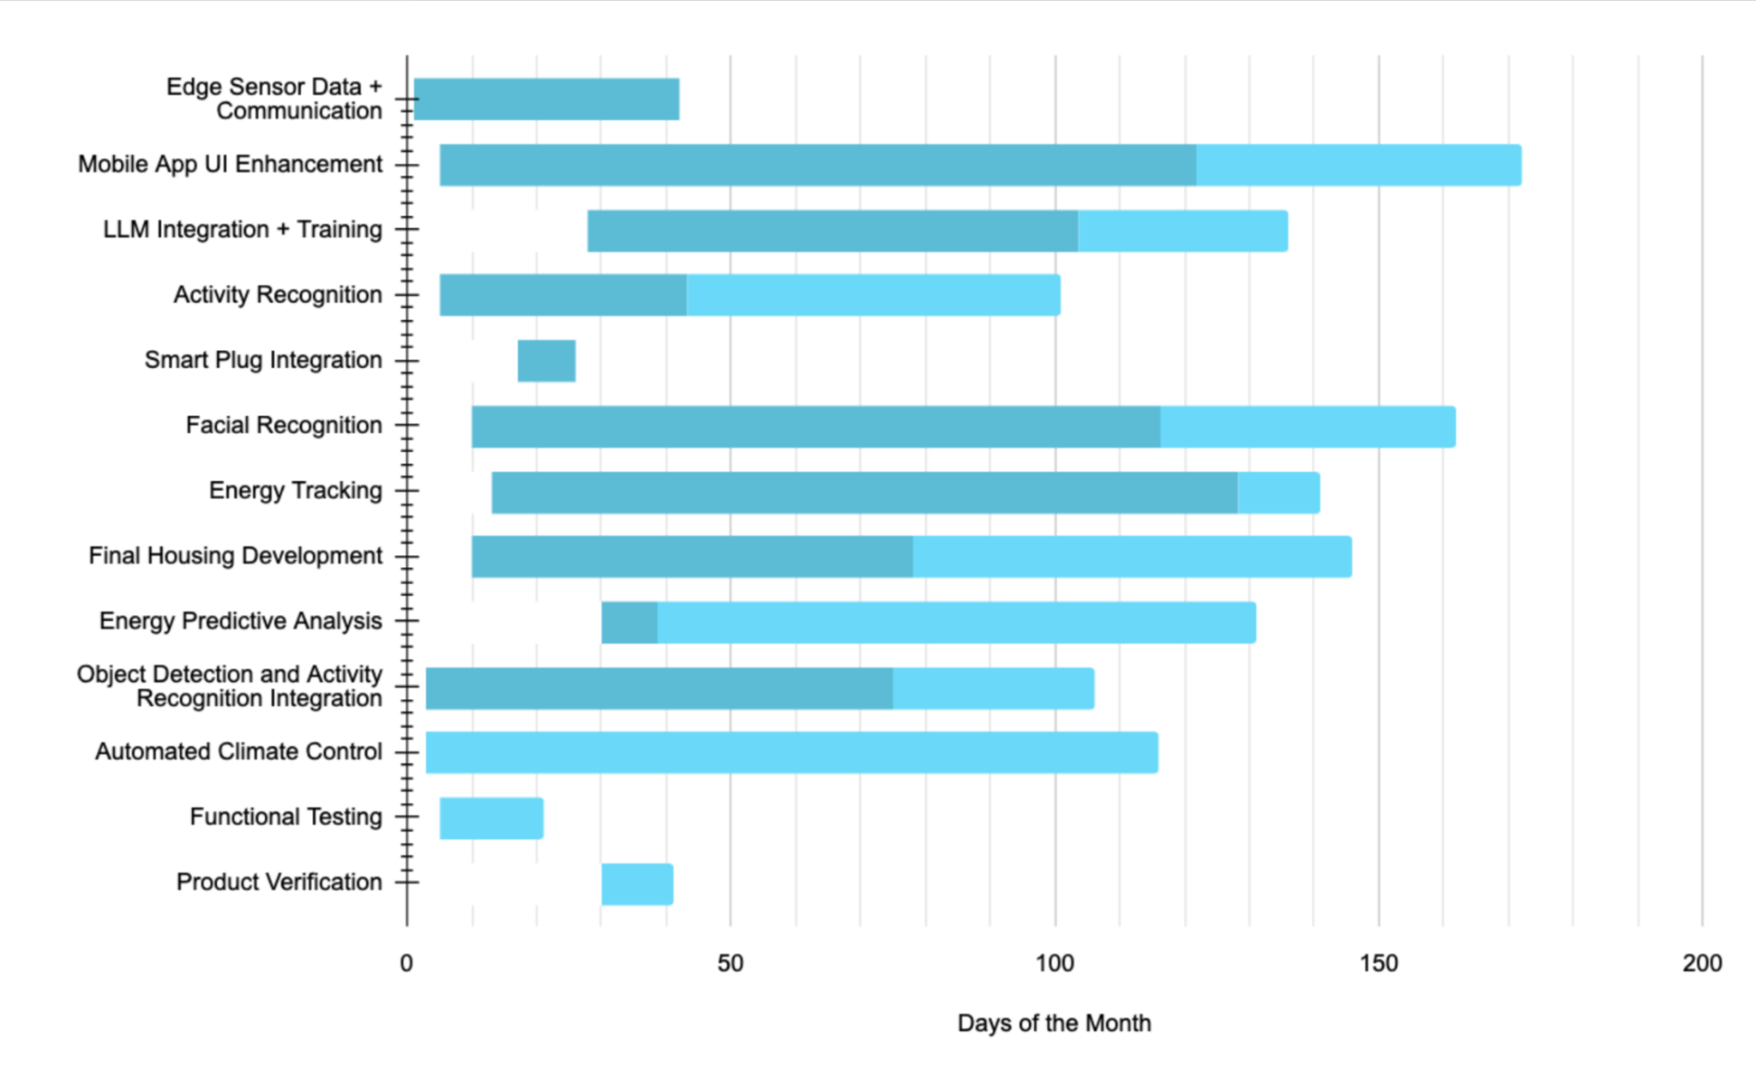
Notes:
Akhil

